Slide 1




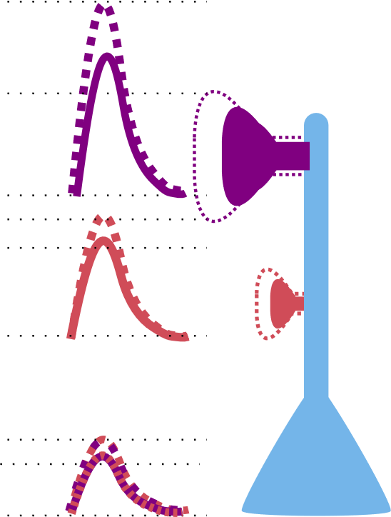
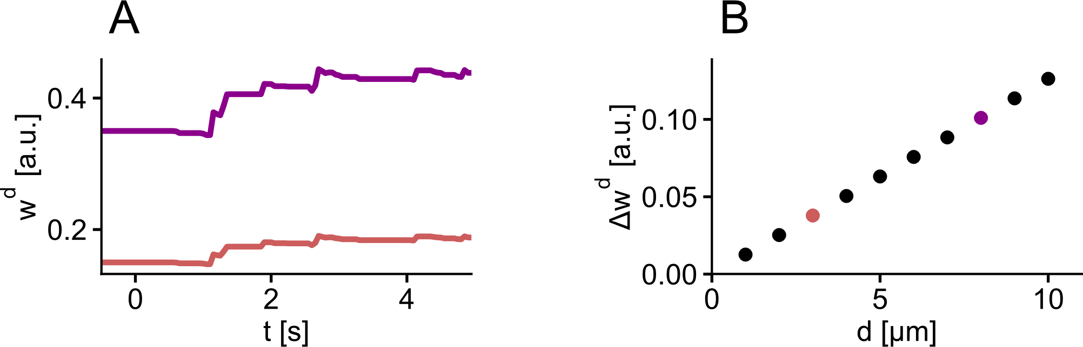
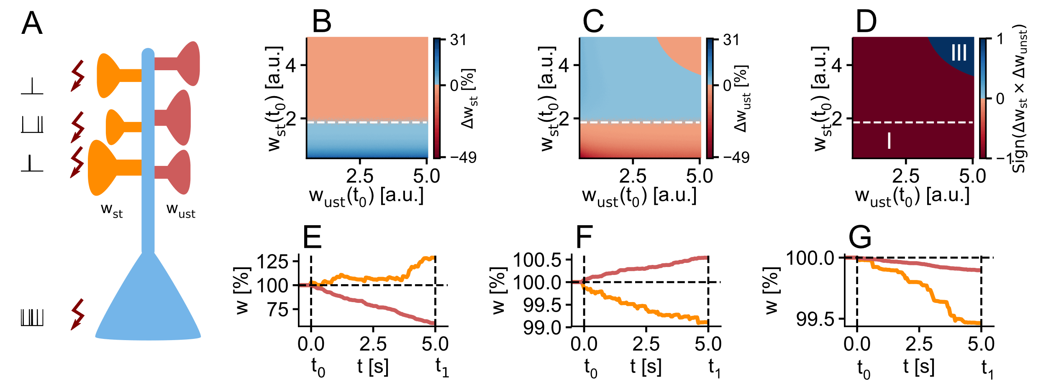
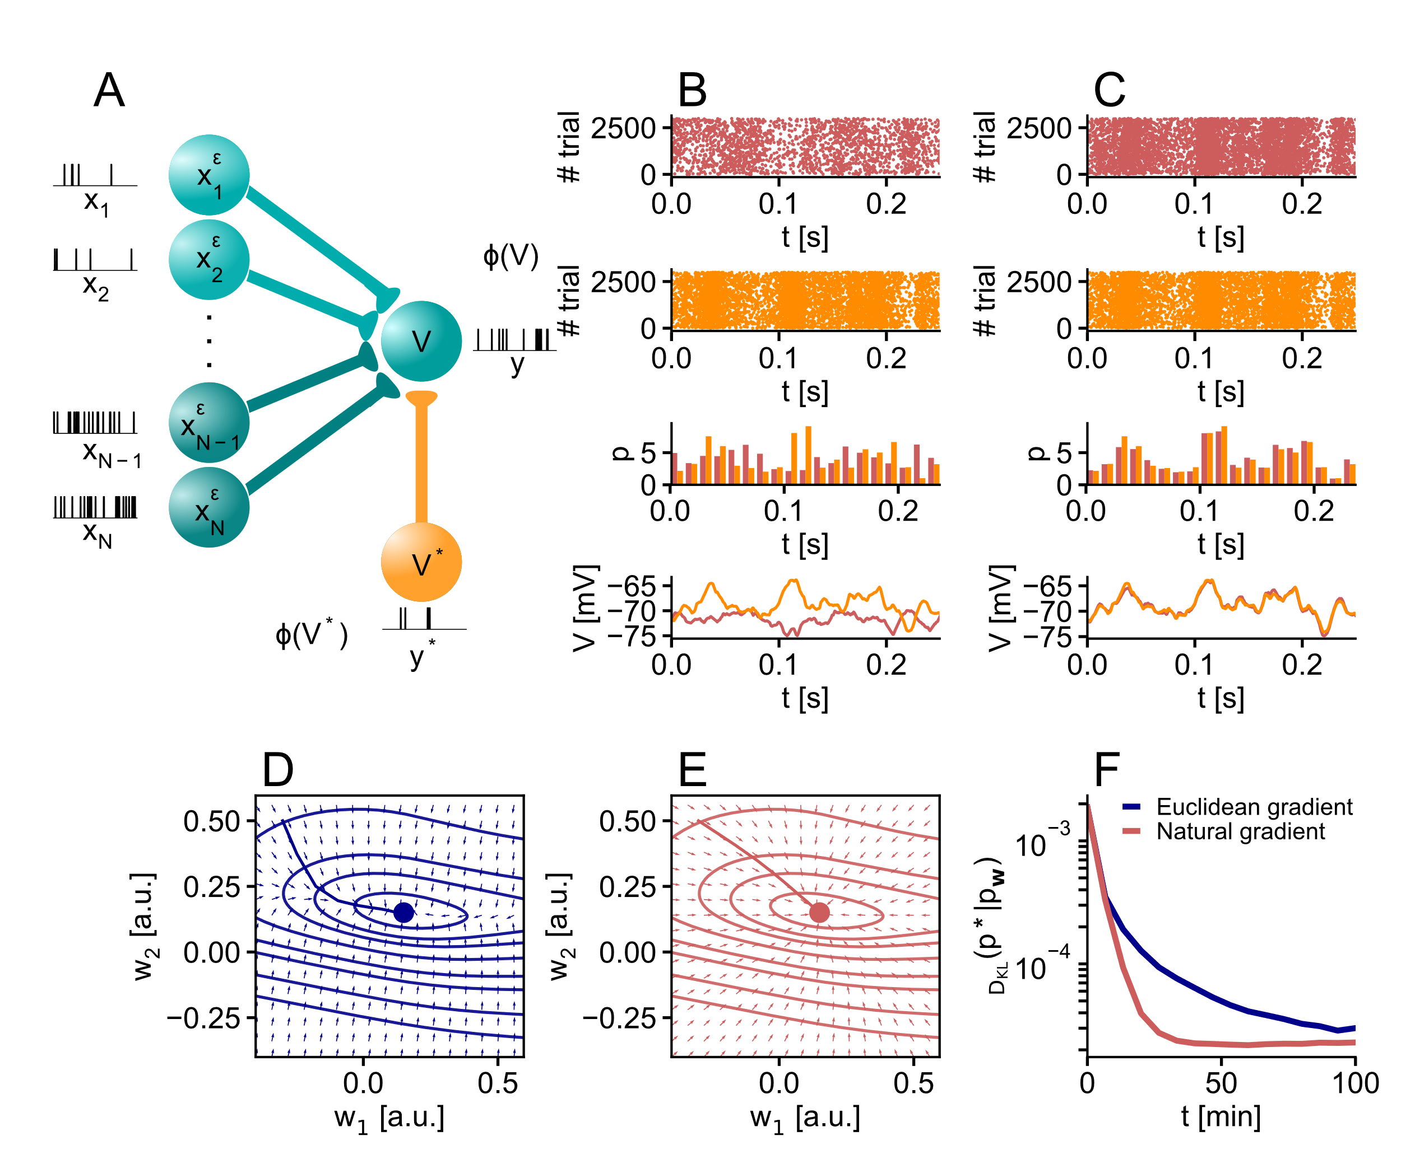
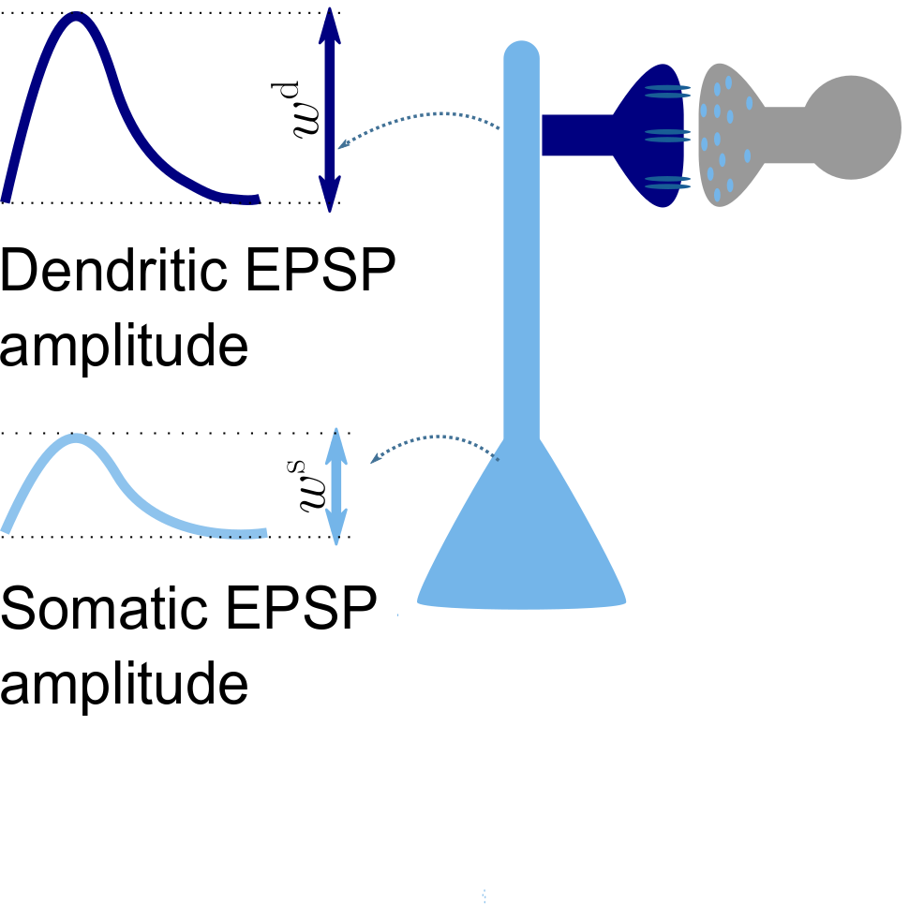
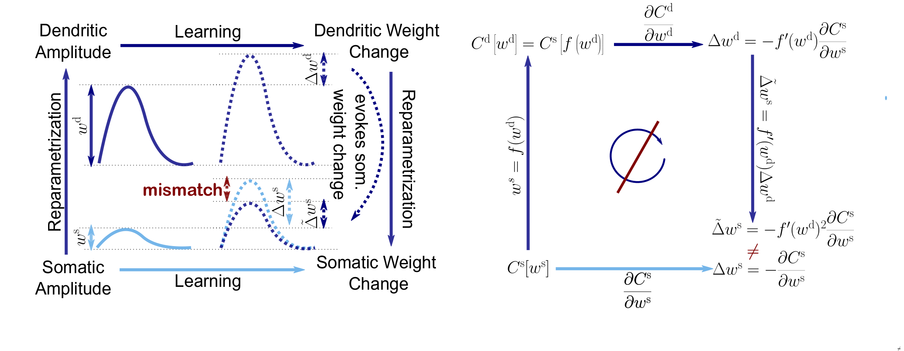
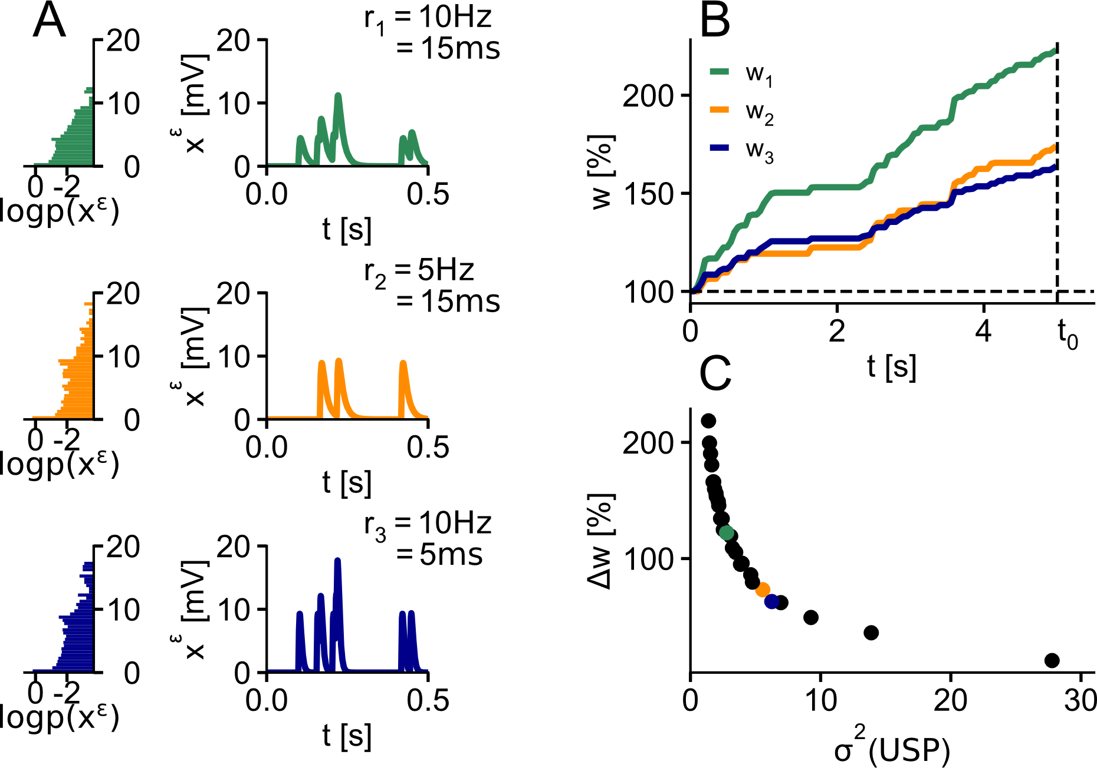
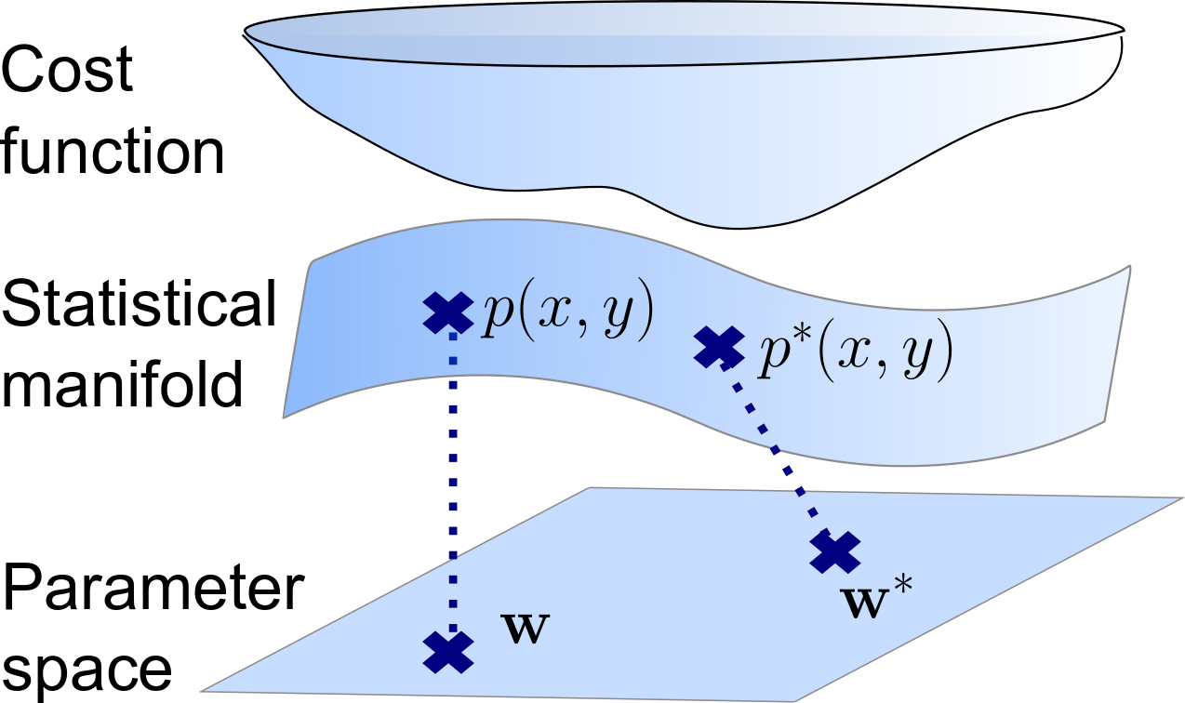

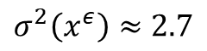
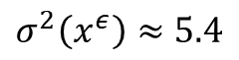
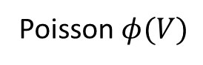
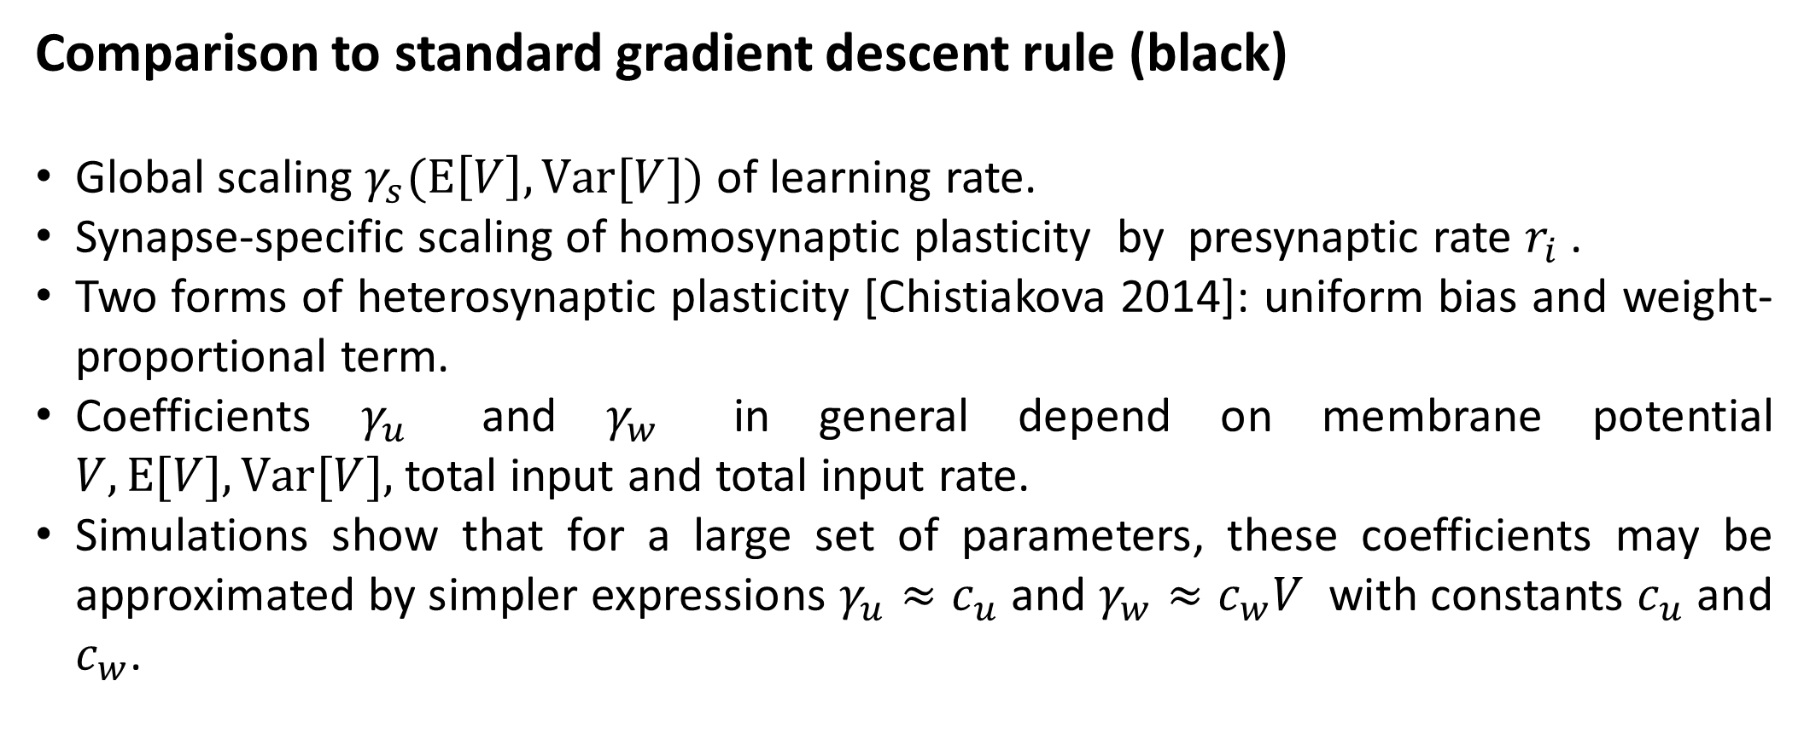
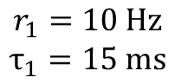
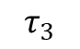
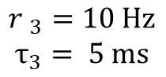
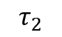
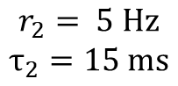
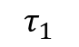
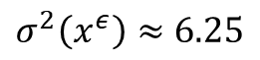
Natural gradient for spiking neurons
${\text{Elena} \text{Kreutzer}}^{1}$, ${\text{Mihai} \text{A}\text{. }\text{Petrovici}}^{1,2}$, ${\text{Walter} \text{M}\text{. }\text{Senn}}^{1}$
$^{1}$Department of Physiology, University of Bern $^{2}$Kirchhoff-Institute for Physics, Heidelberg University
Abstract
Natural gradient learning rule
Stronger synaptic changes in distal dendrites
Due to their simplicity and success in machine learning, gradient-based learning rules represent a popular choice for synaptic plasticity models. While they have been linked to biological plasticity experiments, it is often ignored that their predictions generally depend on a specific representation of the synaptic strength. In a neuron, the impact of a synapse can be described simultaneously by the state of many physical quantities inside the cell. Which one we choose to derive a gradient descent learning rule can have a considerable effect in terms of model prediction. This is dissatisfying both from the viewpoint of fast learning, as well as from a conceptual angle. Plasticity should strive to adjust the neuron's output firing in an optimal fashion, rather than an internal parameter, but classical gradient rules fail to accomplish this goal. Natural gradient descent provides a solution to both problems by following the gradient on the manifold of the neuron's firing distributions, combining the intuition of gradient descent with the elegance of an output change that is invariant under a change of representation. While the computational advantages of natural gradient are well-studied in ANNs, its predictive power as a model for in-vivo synaptic plasticity has not been assessed. We demonstrate that it exhibits faster convergence compared to classical gradient learning in a network of spiking neurons. Furthermore, our approach provides a unified framework for both homo- and heterosynaptic plasticity and predicts plasticity phenomena such as learning rate scaling in distal dendrites.
Task: Output neuron learns to fire according to target distribution delivered by teacher spike train.
$${\dot{w}}^{d}=ηγ_{s}\left[Y^{∗}−φ\left(V\right)\right]\frac{φ^{′}\left(V\right)}{φ\left(V\right)}\left(\frac{{\left(d+1\right)c}_{ε}x^{ε}}{r}−(d+1)γ_{u}+γ_{w}w^{d}\right)$$
$$\dot{w}=ηγ_{s}\left[Y^{∗}−φ\left(V\right)\right]\frac{φ^{′}\left(V\right)}{φ\left(V\right)}\left(\frac{c_{ε}x^{ε}}{r}−γ_{u}+γ_{w}w\right)$$
Comparison to standard gradient descent rule (black)
Global scaling $γ_{s}(E\left[V\right], Var[V])$ of learning rate.
Synapse-specific scaling of homosynaptic plasticity by presynaptic rate $r_{i}$ .
Two forms of heterosynaptic plasticity [Chistiakova 2014]: uniform bias and weight-proportional term.
Coefficients $γ_{u}$ and $γ_{w}$ in general depend on membrane potential $V, E[V], Var[V],$total input and total input rate.
Simulations show that for a large set of parameters, these coefficients may be approximated by simpler expressions $γ_{u}≈c_{u}$ and $γ_{w}≈c_{w}V$ with constants $c_{u}$ and $c_{w}$.
Dendritic amplitude changes under the assumption of linear attenuation of voltages along the dendritic tree. Schema: Synapses in distal dendrites that are functionally equivalent to a proximal synapse in terms of the evoked PSP amplitude at the soma are adapted more strongly. This reminds of the phenomenon of dendritic democracy [Magee2000], but may exist independently from the latter. (A) Example weight traces for functionally equivalent synapses at different positions from soma, under the assumption of linear attenuation along the dendritic tree. (B) Change in PSP amplitude as a function of distance from the soma.
Heterosynaptic plasticity opposes homosynaptic plasticity
Enhanced convergence speed
in a non-isotropic learning task
LTD
Motivation
LTD
LTP
II
Classical gradient-based plasticity models depend on the parametrization of synaptic strength. This leads to inconsistent predictions in terms of output change and can result in inefficient learning.
LTP
LTD
Poisson $φ(V)$
Comparison of homosynaptic and heterosynaptic weight change under a simple stimulation protocol. (A) Half of a neuron's synapses receive input spikes, while a teaching spike train at fixed rate is delivered. The remaining synapses only receive background input. (B) Weight change of stimulated weights depending on initial weight. (C) Weight change at unstimulated synapses. (D) Comparison of (B) and (C) reveals three different plasticity regimes. In most cases, homosynaptic plasticity and heteronsynaptic plasticity counteract each other. This pattern is similar to experimental observations [Royer2003]. (E-G) Example weight traces for the three phases.
Synapse-specific learning rate scales inversely with variance of unweighted synaptic potentials
$$τ_{1}$$
$$r_{1}=10 Hz$$
$$τ_{1}=15 ms$$
$σ^{2}\left(x^{ε}\right)≈$ $2.7$
Natural gradient
Comparison of natural gradient descent and standard gradient descent in a supervised learning task. (A) A neuron had to learn to respond to incoming spike trains by firing according to a target distribution delivered via teacher spikes. Input afferents were divided into two groups, one firing at high and the other at low rate. (B, C) Comparison of student (red) and teacher (orange) spikes and membrane potentia Before (B) and after learning (C). (D) Normalized Euclidean gradient vectors together with contour lines of the cost function (DKL) and weight path during learning. Due to the asymmetric input rates, the cost function is non-isotropic and exhibits a valley. Euclidean gradient vectors are perpendicular to the contour lines. (E) Vector plot and weight path for natural gradient. Natural gradient takes a more direct path to the target. (F) Learning curves for standard and natural gradient descent. Learning rates for the two algorithms were optimized independently.
These problems can be overcome if learning is based on the output rather than an internal parameter [Amari1998]. Natural gradient descent follows the direction of steepest descent on the manifold of the neuron's output distributions instead of the synaptic parameter space.
$$τ_{2}$$
$$r_{2}= 5 Hz$$
$$τ_{2}=15 ms$$
$σ^{2}\left(x^{ε}\right)≈$ $5.4$
$$σ^{2}\left(x^{ε}\right)=\frac{1}{r{\left(τ_{1}−τ_{2}\right)}^{2}} \left(\frac{\left(τ_{1}+τ_{2}\right)}{2}−\frac{2τ_{1}τ_{2}}{τ_{1}+τ_{2}}\right)$$
$$τ_{3}$$
$${r }_{3}=10 Hz$$
$$τ_{3}= 5 ms$$
Funding and References
$σ^{2}\left(x^{ε}\right)≈$ $6.25$
We gratefully acknowledge funding by the European Union under grant agreements 604102, 720270, 785907 (HBP) and the Manfred Stärk Foundation.
Amari, S. I. (1998). Natural gradient works efficiently in learning. Neural computation, 10(2), 251-276.
Magee, J. C., & Cook, E. P. (2000). Somatic EPSP amplitude is independent of synapse location in hippocampal pyramidal neurons. Nature neuroscience, 3(9), 895-903.
Chistiakova, M., Bannon, N. M., Bazhenov, M., & Volgushev, M. (2014). Heterosynaptic plasticity: multiple mechanisms and multiple roles. The Neuroscientist, 20(5), 483-498.
Royer, S., & Paré, D. (2003). Conservation of total synaptic weight through balanced synaptic depression and potentiation. Nature, 422(6931), 518-522.
Learning rate scaling proportional to inverse variance of the unweighted postsynaptic potentials (USP). (A) USP variance was varied while USP mean was kept fixed. The change in variance was evoked either by a change in input rate or by varying the time constant of the synaptic kernel . (B) Weight traces for the different cases in (A). (C) Weight change as a function of USP variance.

